Slide 1
Basic UI One screen
https://www.syncfusion.com/succinctly-free-ebooks/xamarin-community-toolkit-succinctly/creating-the-user-interface-with-c-markup

Slide 2
Let’s start inside a Page: MainPage.xaml.cs
Remember to add
C# Markup (CommunityToolkit.Maui.Markup)

Slide 3
Top common UI from the start
Label / Text
Button / ImageButton
TextBox / Entry / Input
Image / FontIcon
MessageBox / Alert / ActionSheet

Slide 4
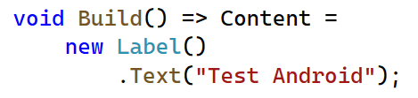
Text

Slide 5
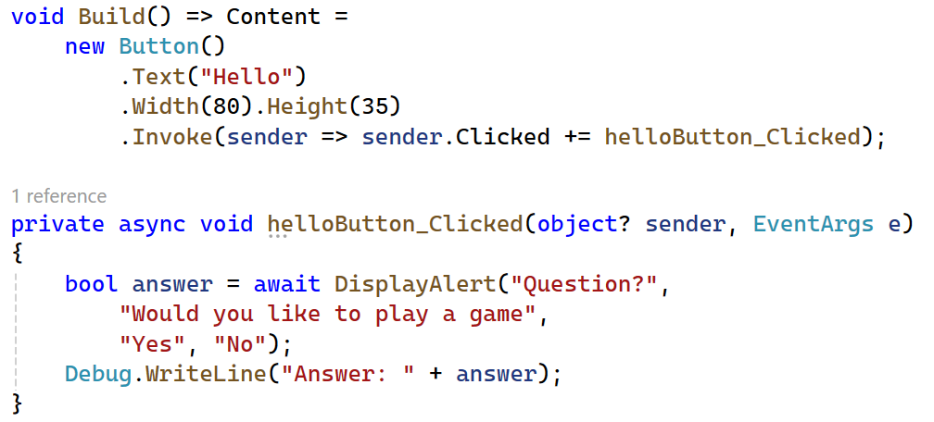

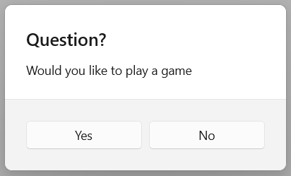
2. Button
https://learn.microsoft.com/en-us/dotnet/maui/user-interface/pop-ups?view=net-maui-8.0
Notes:
void Build() => Content =
new Button()
.Text("Hello")
.Width(80).Height(35)
.Invoke(sender => sender.Clicked += helloButton_Clicked);
private async void helloButton_Clicked(object? sender, EventArgs e)
{
bool answer = await DisplayAlert("Question?",
"Would you like to play a game",
"Yes", "No");
Debug.WriteLine("Answer: " + answer);
}

Slide 6
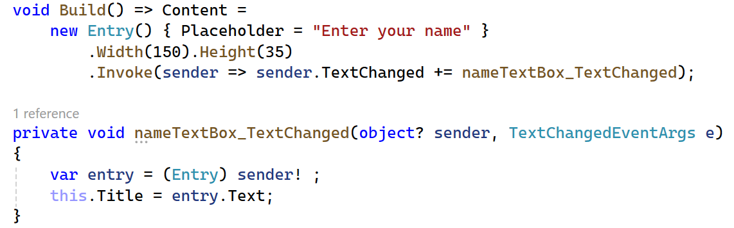
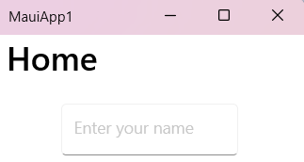
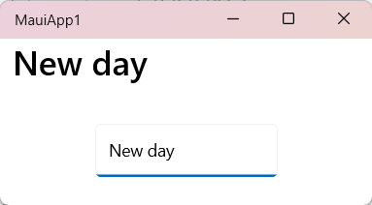
3. Entry
Notes:
void Build() => Content =
new Entry() { Placeholder = "Enter your name" }
.Width(150).Height(35)
.Invoke(sender => sender.TextChanged += nameTextBox_TextChanged);
private void nameTextBox_TextChanged(object? sender, TextChangedEventArgs e)
{
var entry = (Entry) sender! ;
this.Title = entry.Text;
}

Slide 7
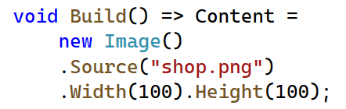

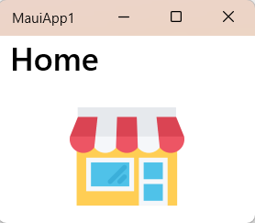
4. Image

Slide 8
Basic layout

Slide 9
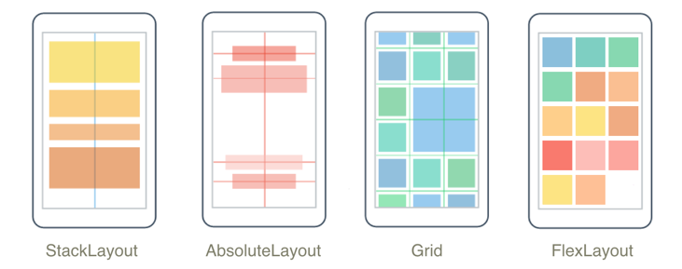
4 main types of layout
Layouts - .NET MAUI | Microsoft Learn

Slide 10
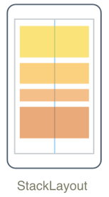
StackLayout
StackLayout - .NET MAUI | Microsoft Learn

Slide 11
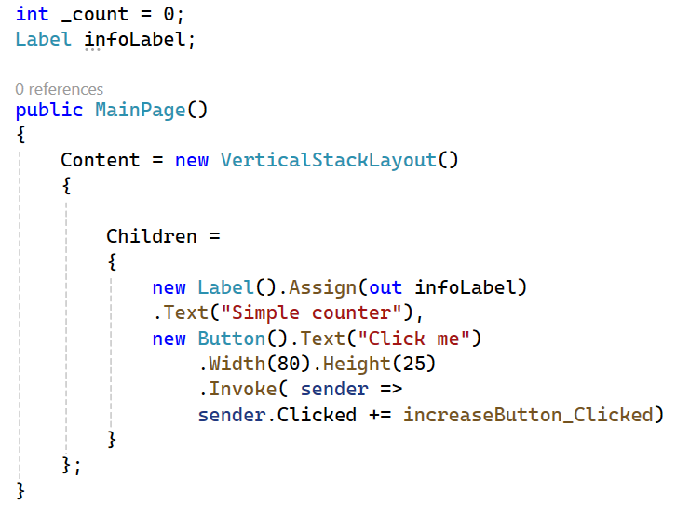
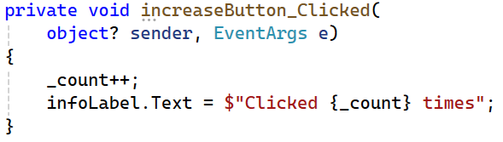
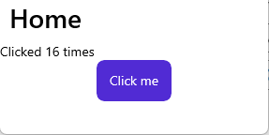
VerticalStackLayout
VerticalStackLayout - .NET MAUI | Microsoft Learn

Slide 12
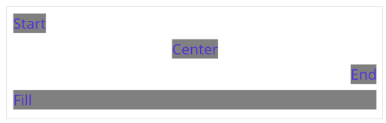
HorizontalOptions

Slide 13
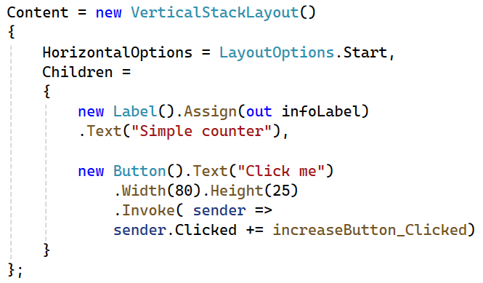
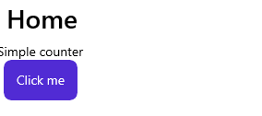
Forcing all left

Slide 14
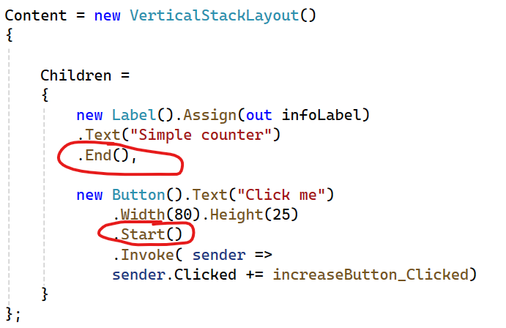
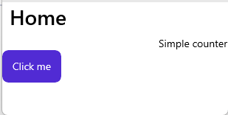
End & Start

Slide 15
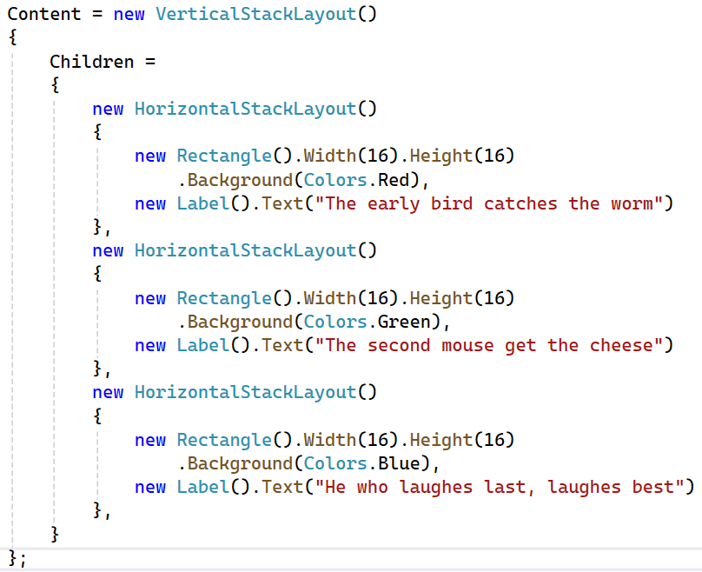
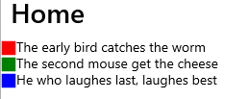
Vertical & Horizontal combination

Slide 16
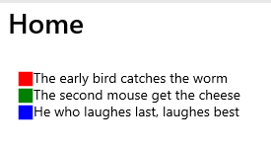
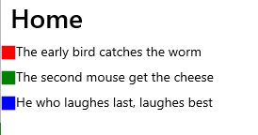
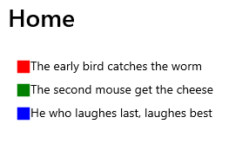
Margin & Spacing
Margin = 20 Spacing = 10 Margin = 20
Spacing = 10

Slide 17
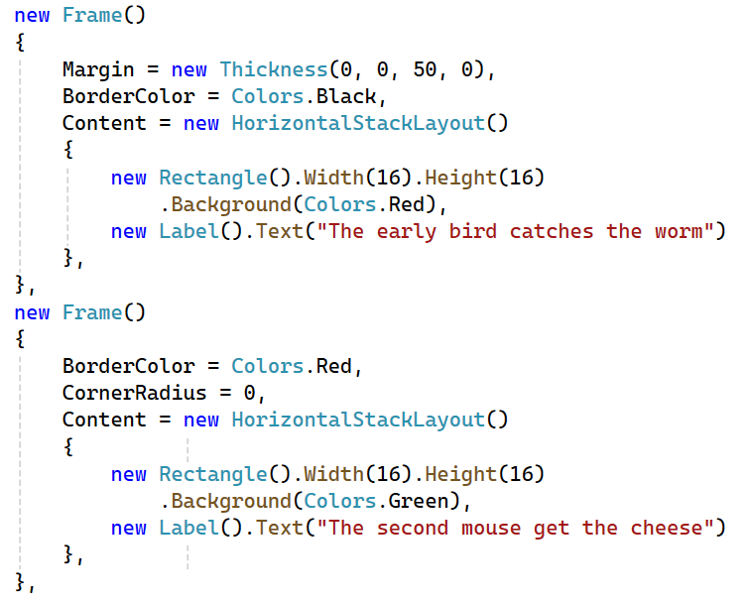
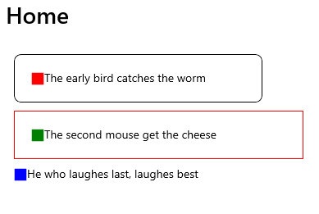
Adding a Frame (deprecated - Border instead)
Notes:
Content = new VerticalStackLayout()
{
Margin = 20,
Spacing = 10,
Children =
{
new Frame()
{
Margin = new Thickness(0, 0, 50, 0),
BorderColor = Colors.Black,
Content = new HorizontalStackLayout()
{
new Rectangle().Width(16).Height(16)
.Background(Colors.Red),
new Label().Text("The early bird catches the worm")
},
},
new Frame()
{
BorderColor = Colors.Red,
CornerRadius = 0,
Content = new HorizontalStackLayout()
{
new Rectangle().Width(16).Height(16)
.Background(Colors.Green),
new Label().Text("The second mouse get the cheese")
},
},
new HorizontalStackLayout()
{
new Rectangle().Width(16).Height(16)
.Background(Colors.Blue),
new Label().Text("He who laughes last, laughes best")
},
}
};

Slide 18
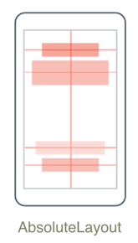
AbsoluteLayout
AbsoluteLayout - .NET MAUI | Microsoft Learn

Slide 19
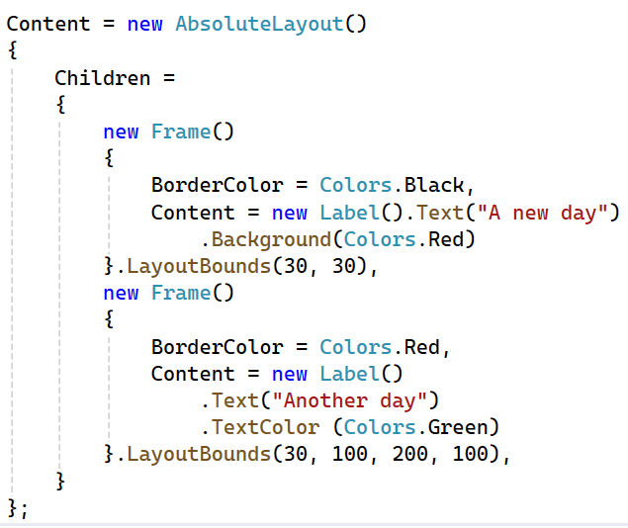
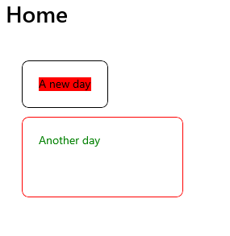
Absolute position
left, top, width, height
Notes:
Content = new AbsoluteLayout()
{
Children =
{
new Frame()
{
BorderColor = Colors.Black,
Content = new Label().Text("A new day")
.Background(Colors.Red)
}.LayoutBounds(30, 30),
new Frame()
{
BorderColor = Colors.Red,
Content = new Label()
.Text("Another day")
.TextColor (Colors.Green)
}.LayoutBounds(30, 100, 200, 100),
}
};

Slide 20
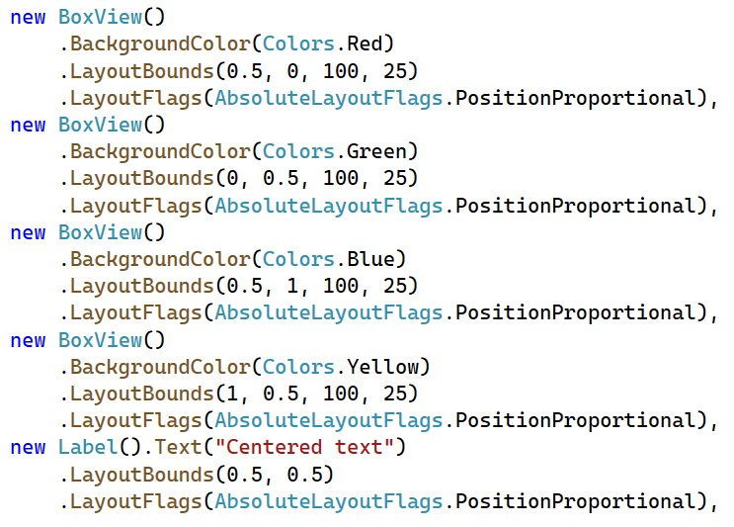
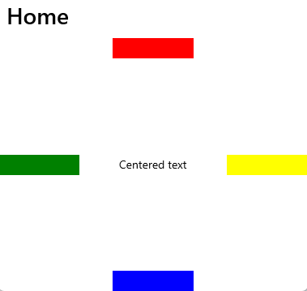
Proportional position

Slide 21
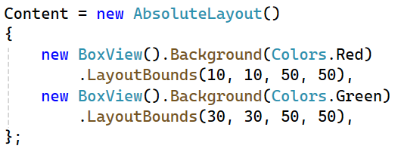
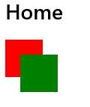
Overlapping

Slide 22
Other options
SizeProportional
All

Slide 23
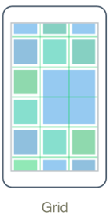
Grid
Grid - .NET MAUI | Microsoft Learn

Slide 24
Grid
Organizes its children into rows and columns
Can have proportional or absolute sizes
Used for layout
For displaying tabular data, use
ListView
CollectionView

Slide 25
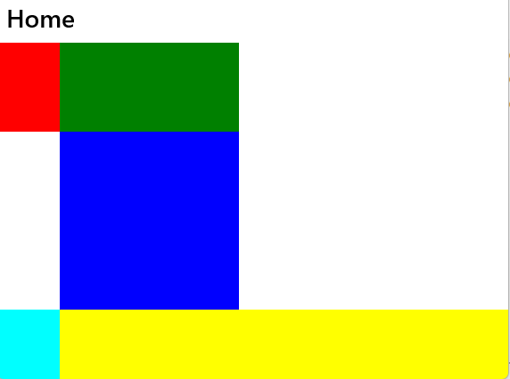
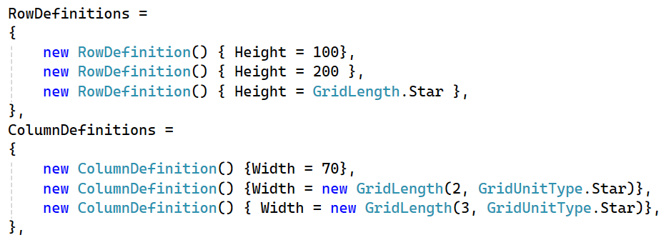
Grid definition

Slide 26
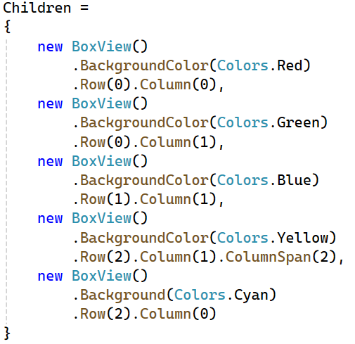
Setting up position

Slide 27
Star vs Auto
Star: use the left space available
Auto: content width will be the column width

Slide 28
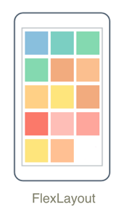
FlexLayout
FlexLayout - .NET MAUI | Microsoft Learn

Slide 29
FlexLayout
Adapt to different screen sizes
Based on the Cascading Style Sheets (CSS) Flexible Box Layout Module.

Slide 30
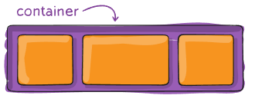
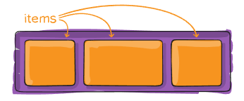
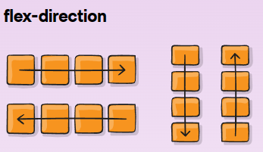
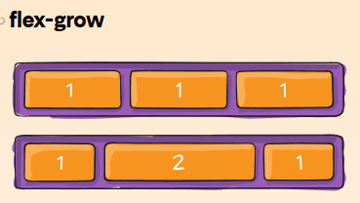
FlexBox model 01
A Complete Guide to Flexbox | CSS-Tricks - CSS-Tricks

Slide 31
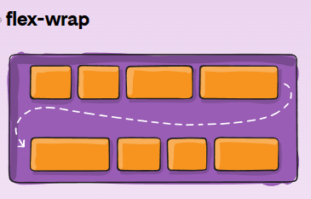
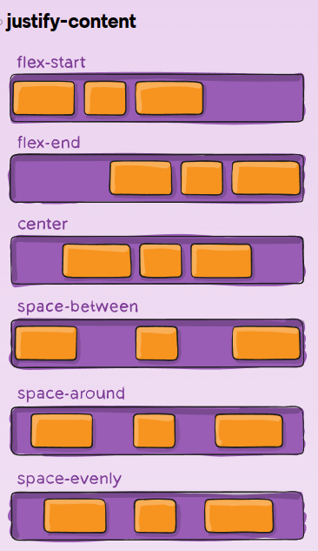
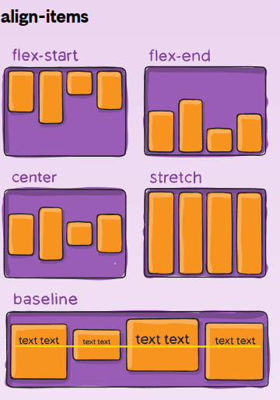
FlexBox model 02
Notes:
space-around: items are evenly distributed in the line with equal space around them. Note that visually the spaces aren’t equal, since all the items have equal space on both sides. The first item will have one unit of space against the container edge, but two units of space between the next item because that next item has its own spacing that applies.
space-evenly: items are distributed so that the spacing between any two items (and the space to the edges) is equal.

Slide 32
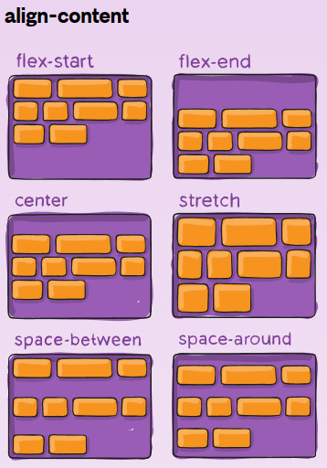
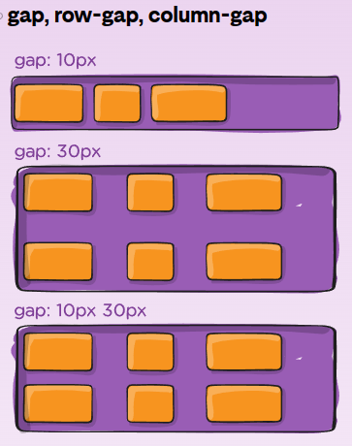
FlexBox model 03

Slide 33
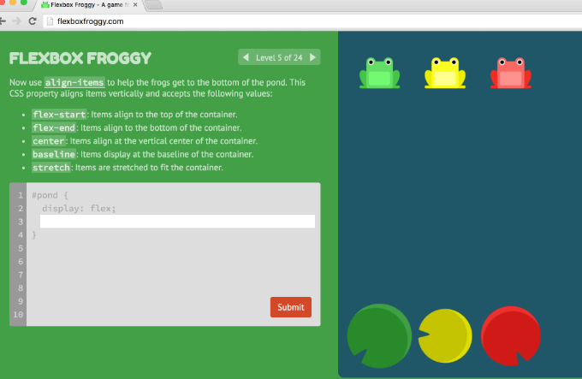
FlexBox Froggy
To understand more about FlexBox, play this game
https://flexboxfroggy.com

Slide 34

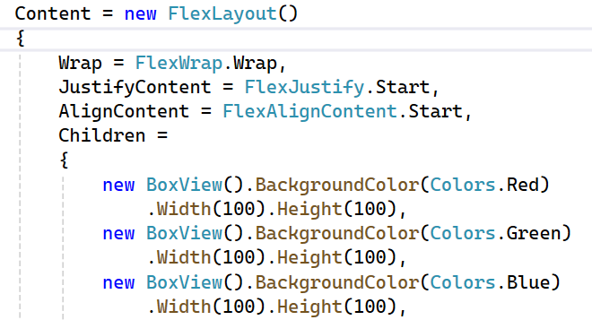
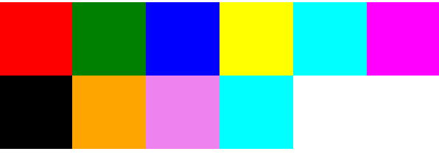
Usage 01 - Wrap Item
Tip: Add ScrollView for scrolling effect

Slide 35
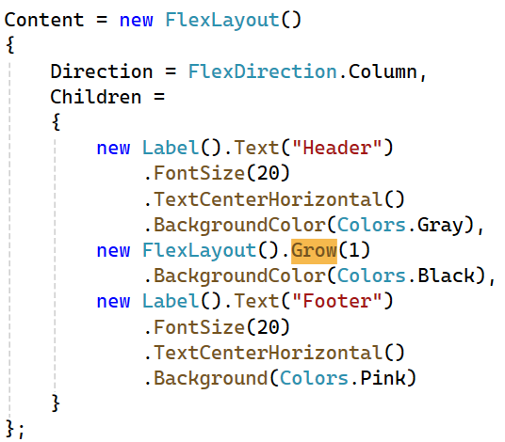

Usage 02 - Page layout: Holy grail - Step 01

Slide 36


Step 02 - Full page layout
Basis: Initial size before dynamic resizing

Slide 37


Step 03 - Dynamic content

Slide 38
Useful UI control

Slide 39
Some buttons
Switch
Slider
Progress
Date Time picker
CheckBox / RadioButton / GroupBox

Slide 40
List of items
ComboBox
ListBox
ListView
TreeView
DataGridView

Slide 41
Data binding

Slide 42


Basic data binding

